Slide 1
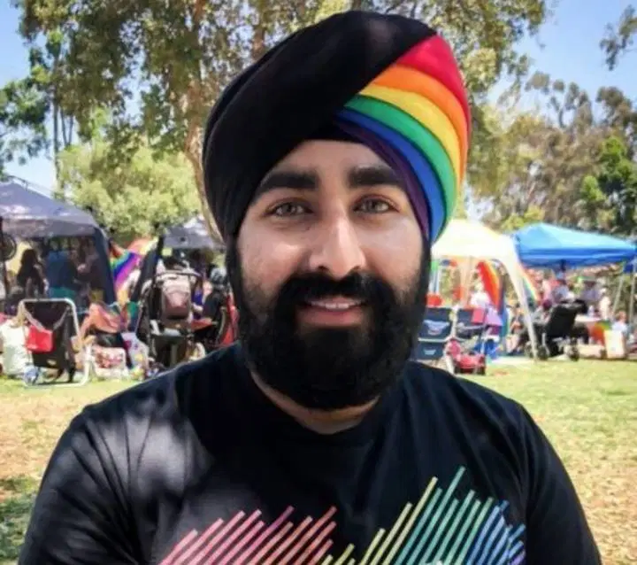
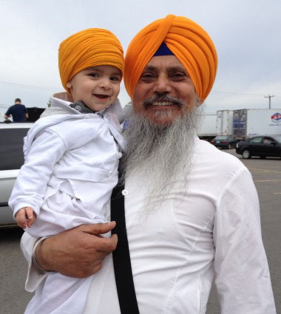
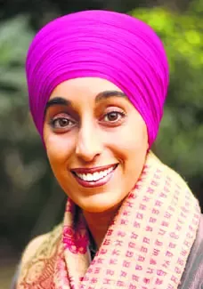
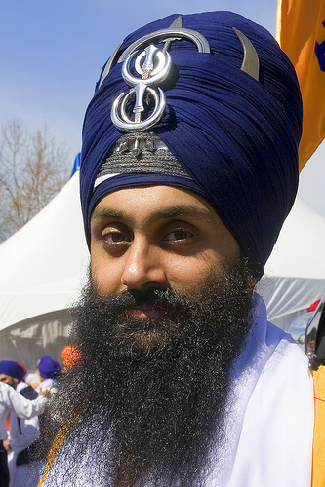
Title: Why is the Turban important for Sikhs in Britain?
Understand why Sikhs may wear a Turban
Explain the significance of the Turban for Sikhs in Britain today
Reflect on why Sikhs may face prejudice because of the Turban
Reflecting on what you already know…
Why do some Sikhs choose to wear a turban?
Why do you think that Sikhs wear different types of Turbans?

Slide 2
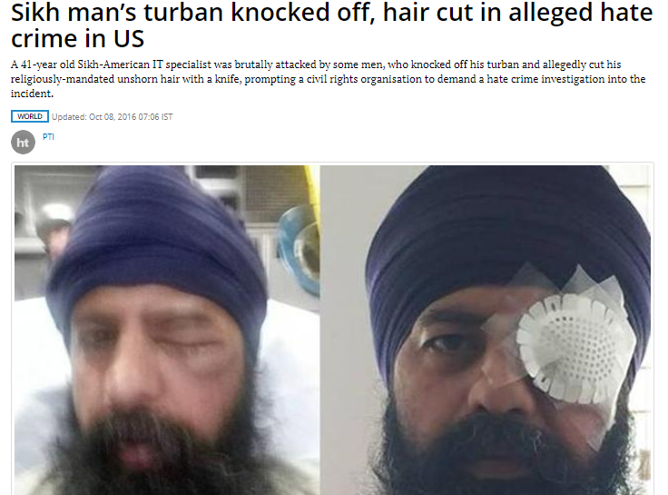
Discuss…
What feelings do you associate with this?
What words do you associate with this crime?
What could be some reasons for this crime?

Slide 3
What is the Turban?
A Turban is an item of headwear associated with Sikhism and is an important part of the Sikh culture.
Among the Sikhs, the Turban is an article of faith that represents honour, self-respect, courage, spirituality, and piety. The Khalsa Sikh men and women, who keep the Five Ks, wear the turban to cover their long, uncut hair (kesh). The Sikhs regard the Turban as an important part of the unique Sikh identity.

Slide 4
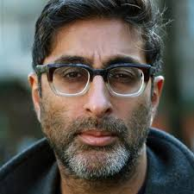
Watch
My Turban and Me
Sanjeev Kohli goes on a personal journey to find out more about the significance of the Sikh turban in Britain today.
https://www.youtube.com/watch?v=zrJUYE6jht0 (play until 16 mins)
You will answer the questions as we watch
Notes:
Play until about 16 mins

Slide 5

Why do you think not all Sikhs wear a Turban?
Discuss, and then write down 2-3 reasons after you have listened to the class discussion.
Challenge: ‘All Sikhs should wear the same turban’ do you agree? Why/why not?
STUCK WORDS
Khalsa, Britain, Culture, Prejudice

Slide 6

On the other hand…
‘All Sikhs should wear the Turban, not just Khalsa Sikhs’
Draw around your hands in your book and add in the reasons why some people may agree in the first, and why some may DISAGREE in the second
Some may agree
Some may disagree
On the other hand…

Slide 7
Before you go
1) Create a true or false quiz based on what you have learnt today. You must include 5 questions.
2) Now complete a peers quiz
3) Swap back and mark their answers in green pen
Challenge: Can you come up with a 12 mark statement and student friendly mark scheme about what we have learnt today?

